Slide 1

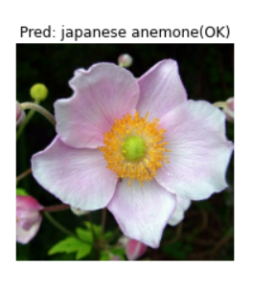
Flower image recognition
Yadan Tang
DSI-823 Capstone Project

Slide 2

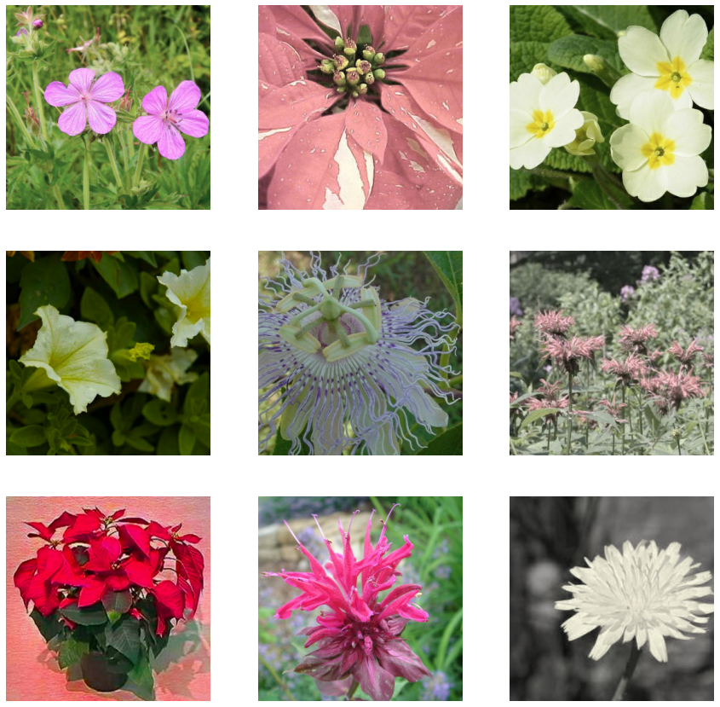

Do you know the names of the flowers?
On earth, there are:
5,000 species mammals
10,000 species of birds
30,000 species of fish
Astonishingly, over 400,000 types of flowers!
Many times, I found myself enjoying and recognizing the flower, but cannot name it!

Slide 3




There are many commercial Apps (free and purchased) for flower/plants identification by submitting an image.

Slide 4
Outline
Data Source:
Kaggle metal_to_petal multiclassification on TPU challenge
Class: 104 different types of flowers
Tfrecord Data:
Train: 12753 images with labels
Val: 3172 images with labels
Test: 7382 images unlabeled
Image size: 331 x 331
EDA
Load Tfrecord dataset from GCS
Unpack images and labels/IDs
Image normalization
Image augmentation – Random change saturation and contrast, Random flip
Modeling
CNN baseline model
Xception pretrained model and hyper parameter fine-tune
Model prediction and evaluation
Plot confusion matrix
Display images with predicted and actual classes

Slide 5
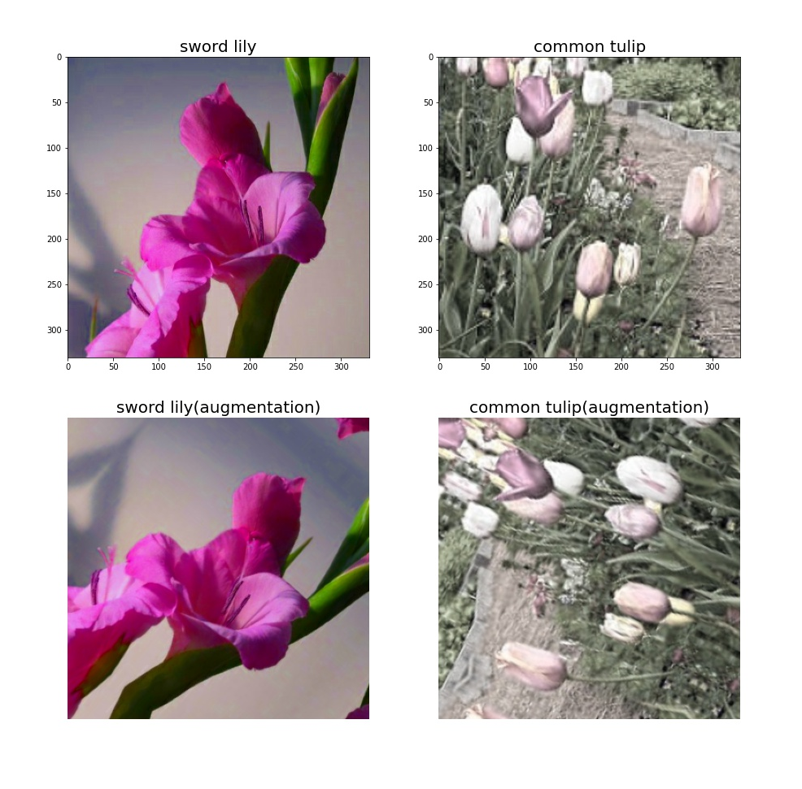
Image Augmentation
Random flip
Random alter contrast
Random alter saturation
Random rotation

Slide 6
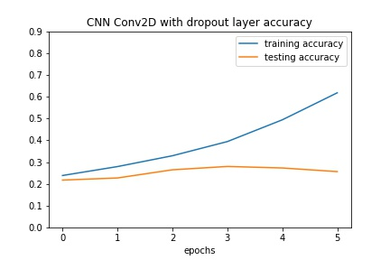
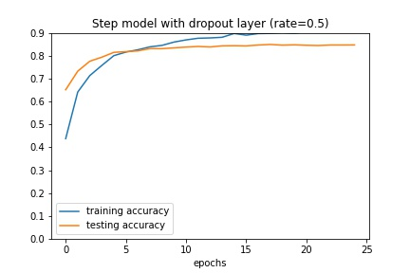
Xception pretrained model vs. CNN baseline model
Baseline CNN model
Xception pretrained model

Slide 7
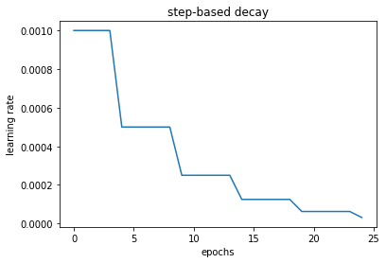
Learning rate Algorithms

Slide 8
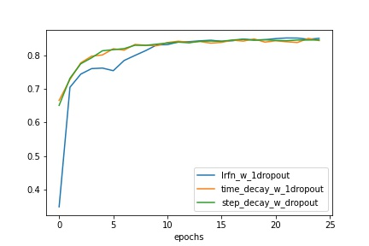
Learning rate

Slide 9
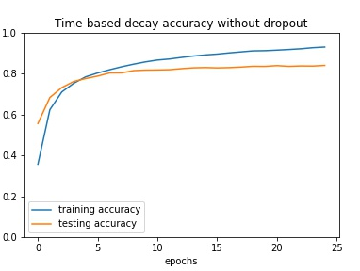
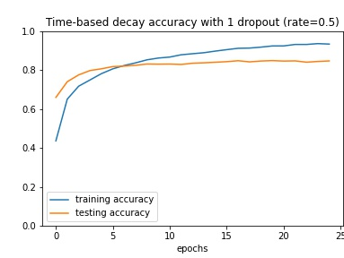
Dropout/ IMAGE AUGMENTATION
Dropout layer
Does not impact

Slide 10
Impact of hyperparameters on model performance
60%
CNN vs Pretrained model
Significant improvement as compared to CNN baseline
Image augmentation (rotation, flip)
Minimal improvement
<1%
~1-2%
Dropout layer/rate
<1%
Dropout layer control overfit
Optimum layer = 1 and drop_rate = 0.5
Learning rate(LR)
Different LR leads to similar val_accuracy
Time-base and step-wise better than lrfn-decay

Slide 11
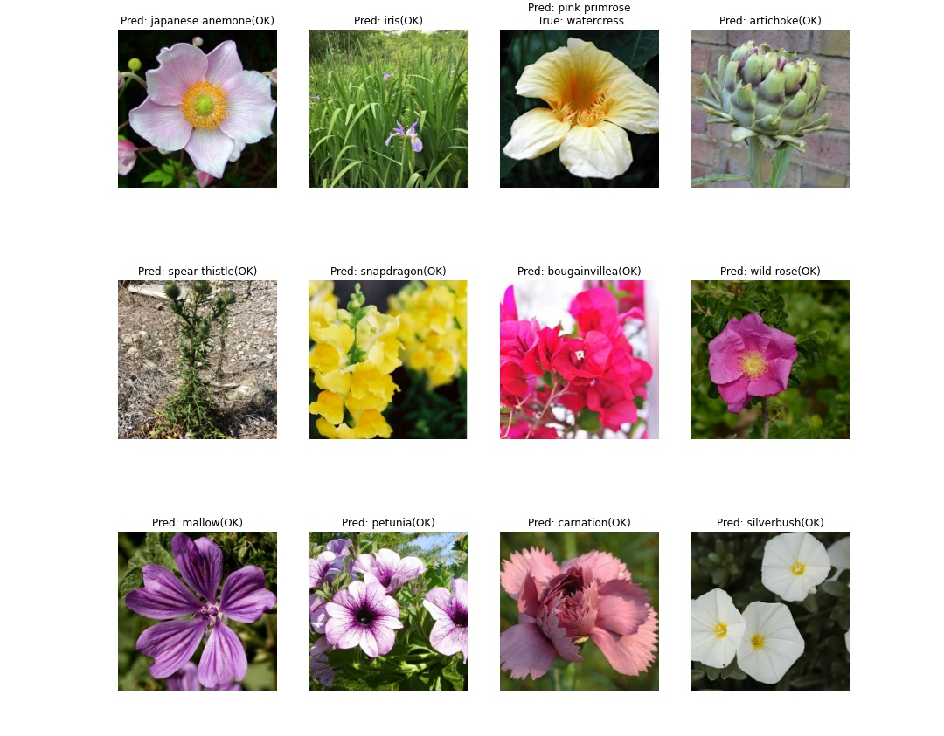

Slide 12
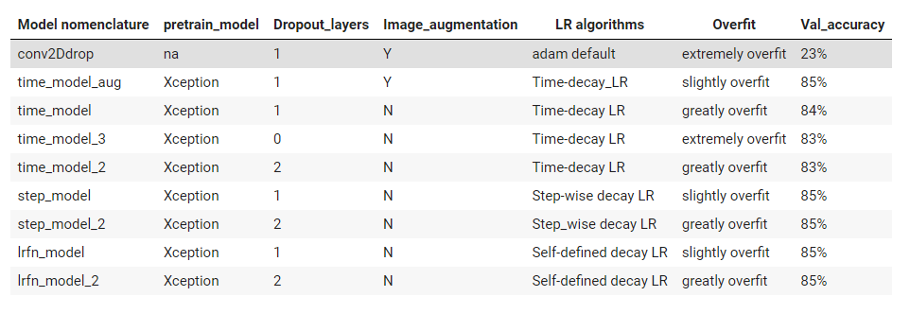
Model performance summary

Slide 13
Summary of model performances
All LR algorithms have similar val accuracy (83-85%), but models with time_based decay and step_wise decay able to reach optimum val performance at less epochs than lrfn_decay.
dropout_layer: 1 dropout layer with drate_rate = 0.5 is the best params
image_augmentation: additional image_augmentation such as random rotation and random flip does not further impact on the validation accuracy.
Learning rate(LR) Algorithms: time-based and step-wise decay both worked similar, lrfn_decay has lower val_performance at less epochs (epochs <10).

Slide 14
Credits
Credits to the following resources which inspired and educated me
Special Thanks to Caroline S. for consulting and tips
GCS connection with Colab instructions [link]
Tensorflow callbacks documentation [Documentation link]
Tensorflow image processing documentation [Documentation link]
Modeling using Keras image recognition pretrained model [Robert Border][Umar Farooq]
Learning rate scheduler and callback functions [Bachr Chi][Udacity PyTordh Chllengers]

